Slide 1

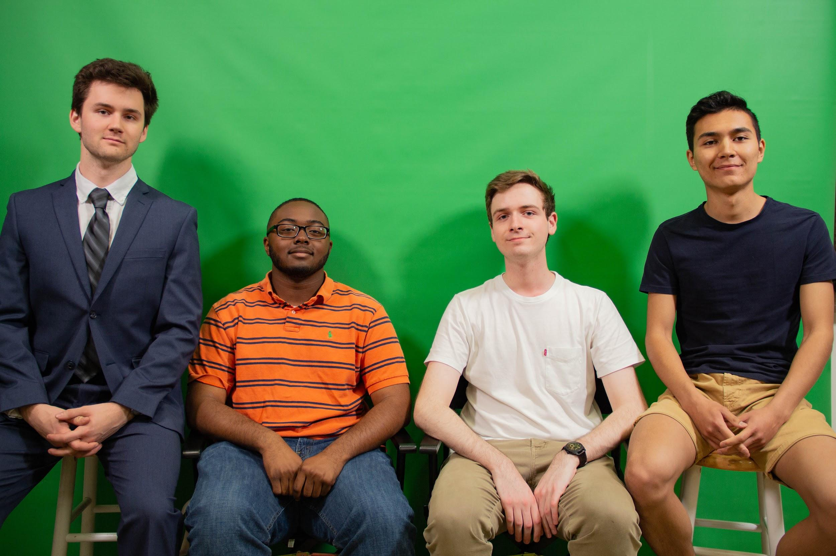
Escape the Planet
EF 152 Spring 2019
Team C216-3:
Andrew Kloek
Andrei Cozma
Marcus McCoy
Refati Rusitanmu (Rus)
4/4/2019
www.andreicozma.com/projects/EF152

Slide 2
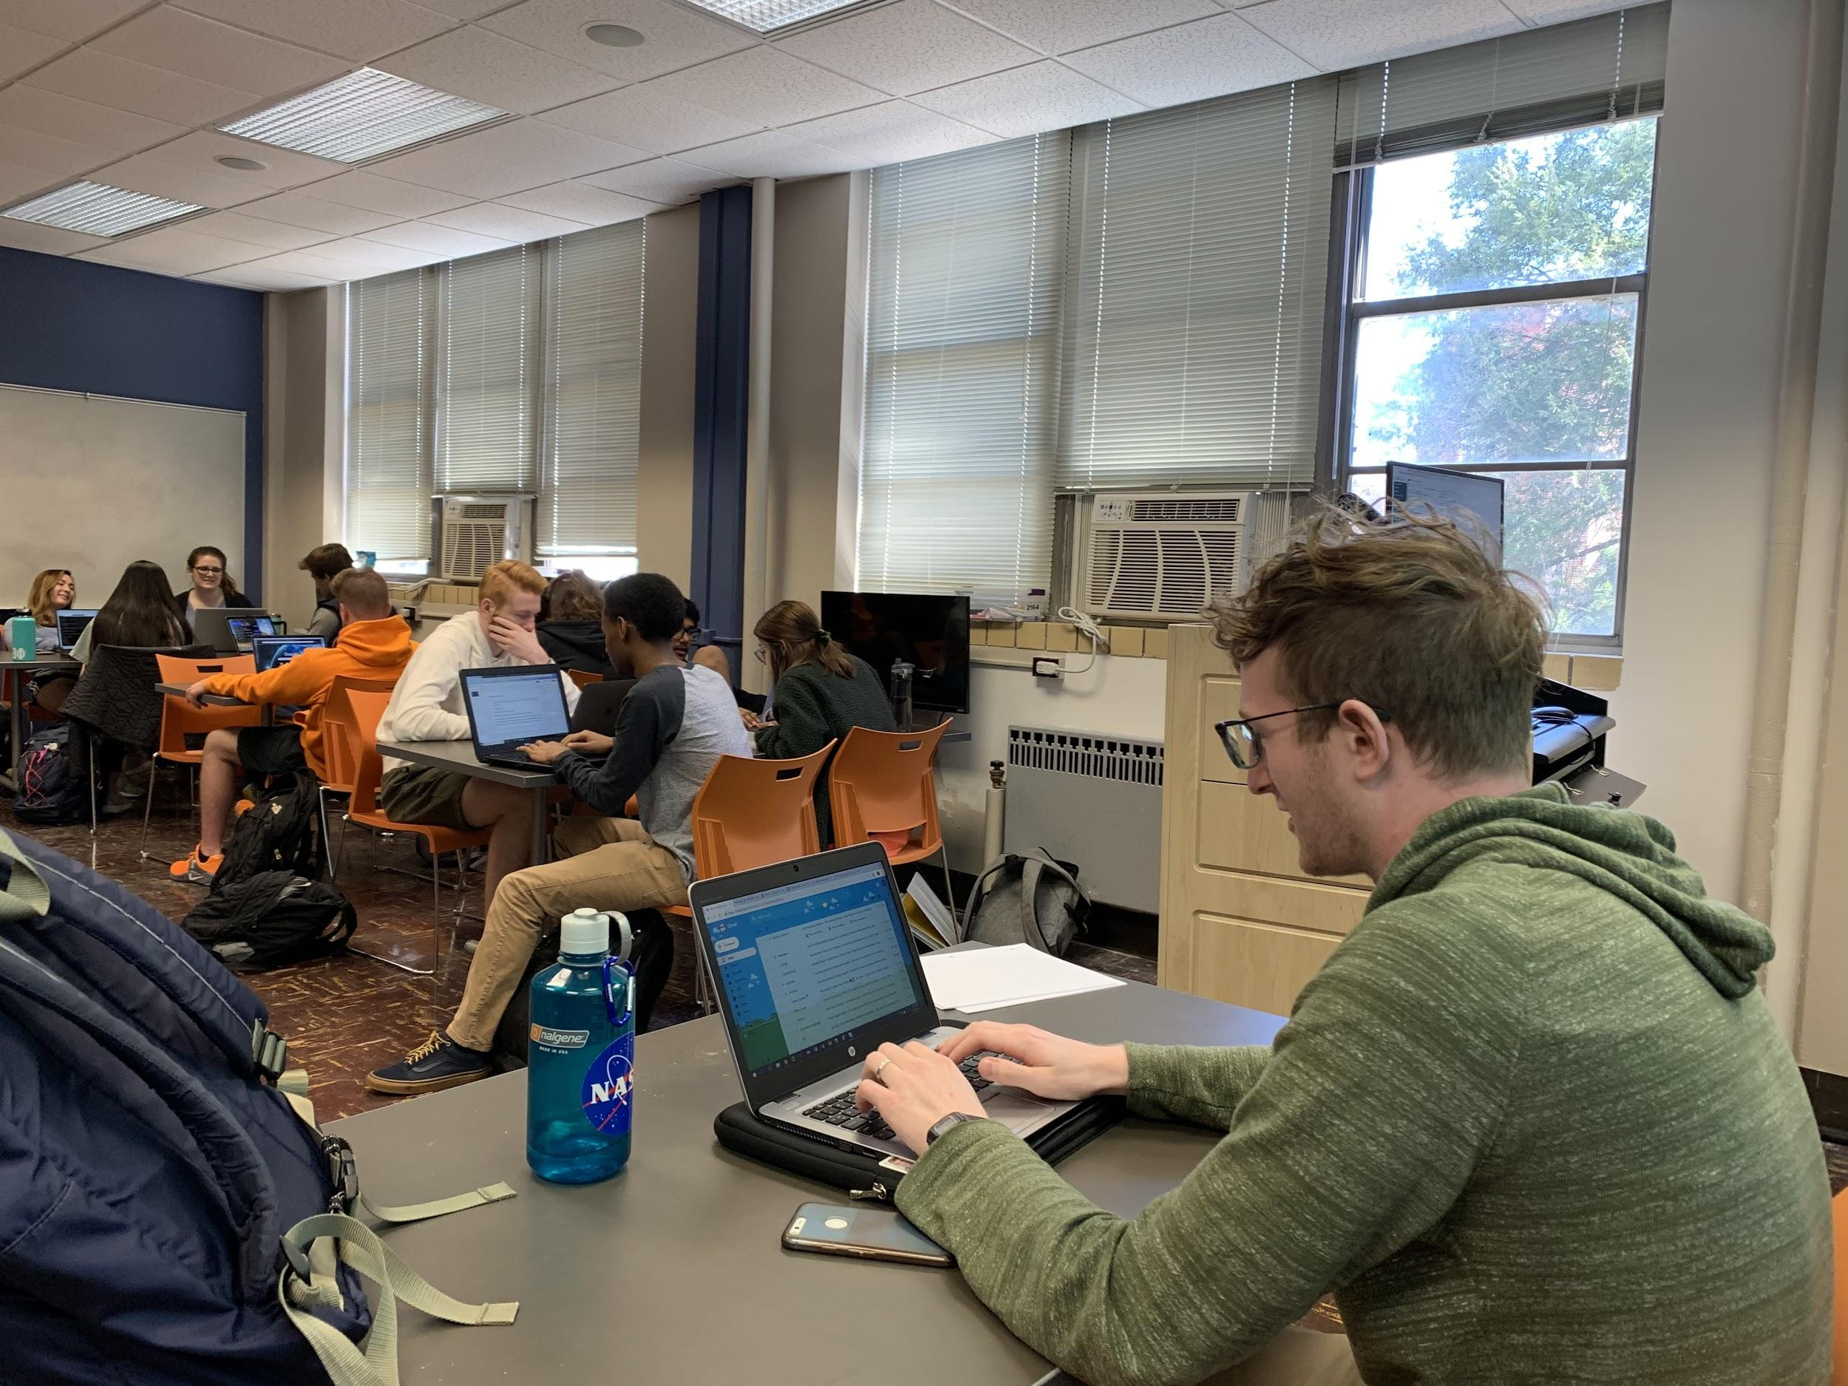
Target Audience
College or High School Students
Physics Classrooms & Labs
People who are interested in learning a physics concept
Objective
We chose to create a product to offer a free and easy way to learn the processes behind escape velocity and gravitation

Slide 3
Conceptual Design
The web application allows the user to learn and experiment with physics concepts like escape velocity and gravitation through a fun and interactive online simulation.
Initial Design & Iterations
The design started by rendering simple shapes on a web-page, such as circles, squares, and various other elements
A space background was added along with a rocket and the planet
By adding input elements such as sliders, we were able to manipulate visual elements on the screen in real time
Physics equations were then implemented to accurately model the interactions between the planet and the rocket

Slide 4
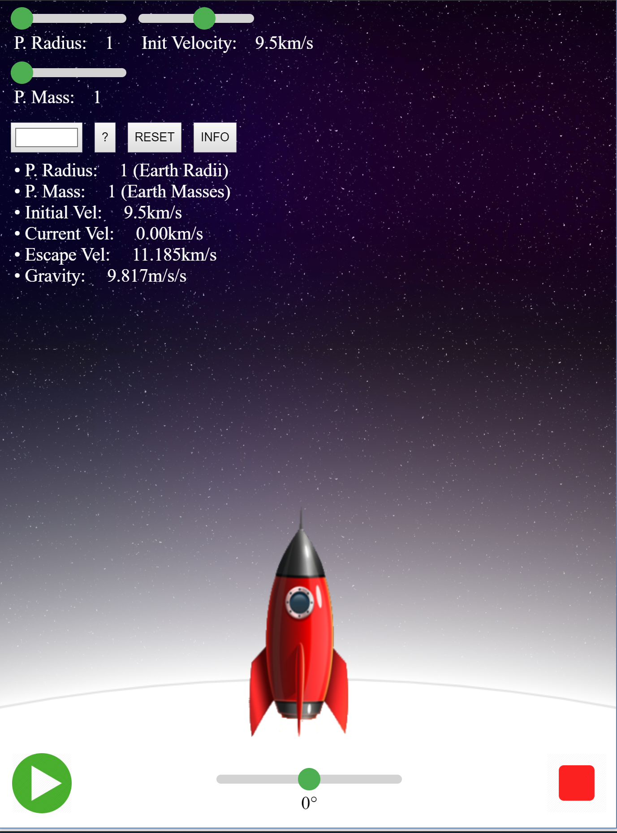
Actual Design
Main elements:
A rocket
A planet
Features:
Manipulate mass, radius, initial velocity, and rotation through input elements
Goal:
Discover how changing various properties of the elements influences the interaction between the planet and the rocket

Slide 5
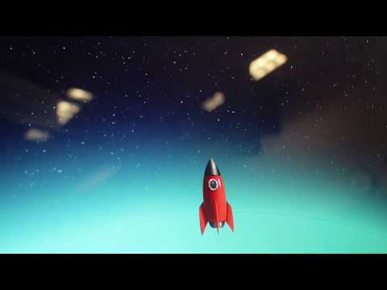
Marketing Video

Slide 6


Customer Feedback and Results
For our feedback, we reached out to many different web app developers to get insightful tips to help make our simulation successful.
Key notes our client gave us is to make our simulation as user-friendly as possible. We intend to simplify our simulation as much as we can to make it user-friendly as well as include fun graphics.

Slide 7
Customer Feedback and Results cont.
After taking development suggestions from Magoosh and making improvements, we used further input from a set of other engineering students in EF152
Caleb Noe - The program was cool and informative, if possible could you add the formulas that are used to solve some of the variables?
Quentarius Matlock - The program is something I would have used if I didn’t understand the concept. It is user friendly and free, but maybe you could add some sound effects to the rocket?

Slide 8

Cost and Time Estimates
Design Materials and Cost: Considering all factors for production (Laptop costs, Software Engineer wages, Graphic Design wages, etc…), our estimated cost for development comes out to be roughly $3500
Design Time: Four students combined worked a total of 75 hours, with the majority of time being spent on coding.
Material Cost for 1000 Units: N/A (Website is one unit accessible to everyone)
Retail Price for One Unit: We plan to offer our simulation for free, and setup ads on our website to generate passive revenue to pay for basic website hosting costs.

Slide 9
Conclusion
This is an educational orbital motion simulation that helps people understand the concept of escape velocity and gravitation. Our simulation combines fun graphics with real physics concepts to create a product that serves to teach the user properties of orbital motion. We want everyone to be able to learn something new, which is why we are not charging people to use our website.

